Slide 1



Slide 2
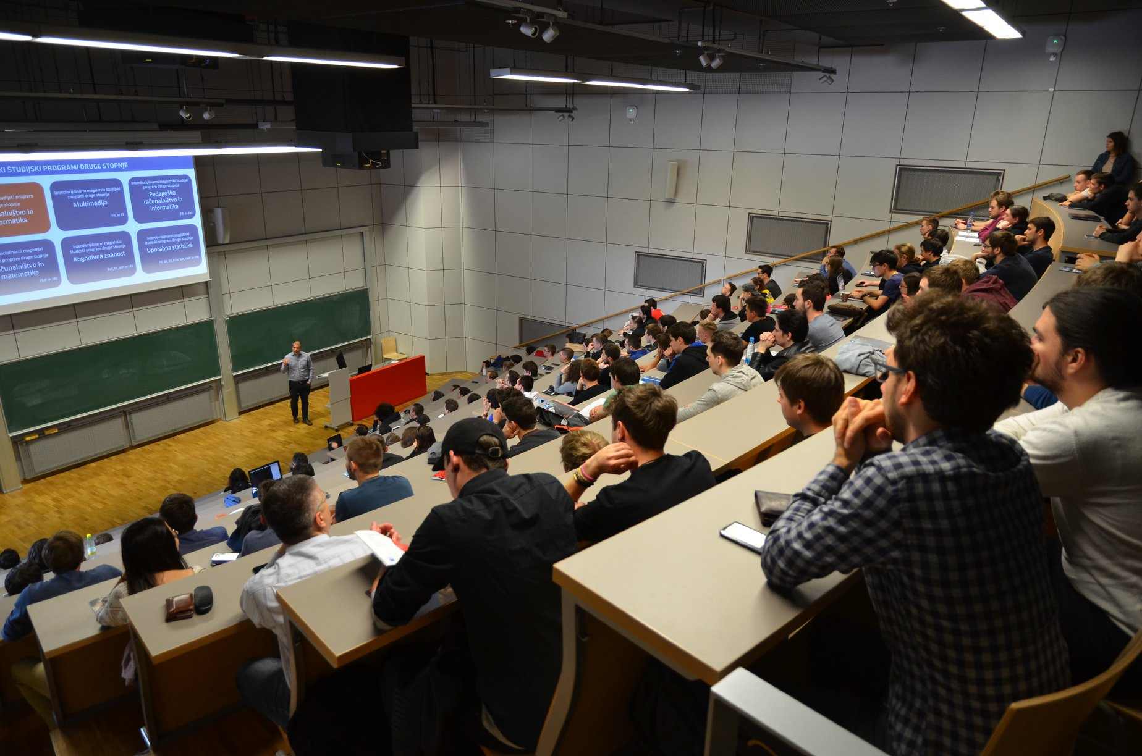
Top students from engineering, mathematics, physics.
Goal: Highly-trained versatile data engineers and data scientists.
in English,
2 years, full-time.
DATA SCIENCE
MASTER‘S

Slide 3
Top students from engineering, mathematics, physics.
Goal: Highly-trained versatile data engineers and data scientists.
in English,
2 years, designed for full-time study.
DATA SCIENCE
MASTER‘S

Slide 4
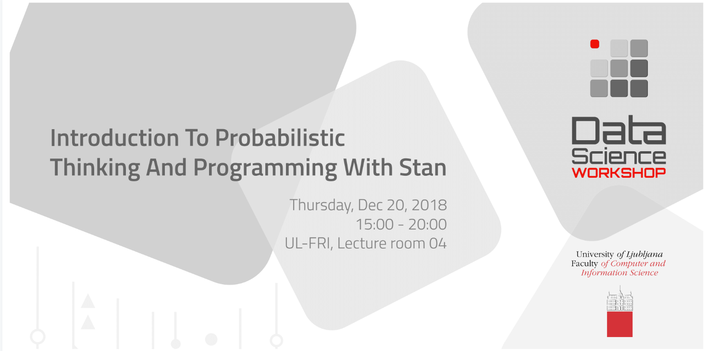
PROFESSIONAL SKILL DEVELOPMENT
Monthly free workshops.
Weekly discussions.
Subscribe at datascience.fri.uni-lj.si

Slide 5
PROFESSIONAL SKILL DEVELOPMENT
Monthly free workshops.
Weekly discussions.
Subscribe at datascience.fri.uni-lj.si

Slide 6


PARTNERSHIP PROGRAM
Collaboration with industry,
building a community.

Slide 7
PARTNERSHIP PROGRAM
Collaboration with industry,
building a community.

